Slide 1

Robotic Process Automation of Supply Chain Management for Healthcare
Group No. 18
Hitarth Saiya 19204007
Samyak Doshi 19204001
Jash Seth 19204006
Prof. Vishal Badgujar Prof. Geetanjali Kalme

Slide 2
Contents
1. Introduction
2. Objectives
3. Problem Definition
4. Technological Stack
5. Review Suggestions (Given in Last meeting)
6. Proposed System Architecture/Working
7. Implementation Status
8. Status of Paper Draft & Targeted Conference

Slide 3
INTRODUCTION
Problem Identified:
In many companies SCM is a manual process which is a time consuming
and prone to human errors.
Finding a particular record takes more time.
Solution Proposed:
We wish to automate the SCM of Healthcare by using RPA tools.
Aim to automate the manual process of vendor selection & onboarding,
inventory management and order processing.

Slide 4
OBJECTIVES
1. To Design an efficient vendor selection algorithm.
2. To automate Vendor Selection and Vendor On boarding Processes with the
help of RPA.
3. To automate Order Processing and Inventory Management Processes using RPA tool .
4. Maintaining adequate stock of medications.
5. Minimizing the occurrence of unavailability of medications.
6. Reduction of cost of maintaining an inventory.
7. Limiting the use of resources for purchasing tasks.
8. To contribute to the overall profitability of the healthcare organization.

Slide 5
PROBLEM DEFINITION
Most of the existing supply chain management processes are manual.
Scope of error are naturally high.
The management has to do the tedious task of reading the quotations from multiple vendors and comparing these quotations based on multiple factors.
Shortlisting and selecting the best quotation is a very difficult task.
More time consuming.

Slide 6
TECHNOLOGICAL STACK
RPA Tool (BluePrism)
SQL Express (For storing the data)
Python (For vendor selection algorithm)

Slide 7
REVIEW SUGGESTIONS
No Suggestions.

Slide 8
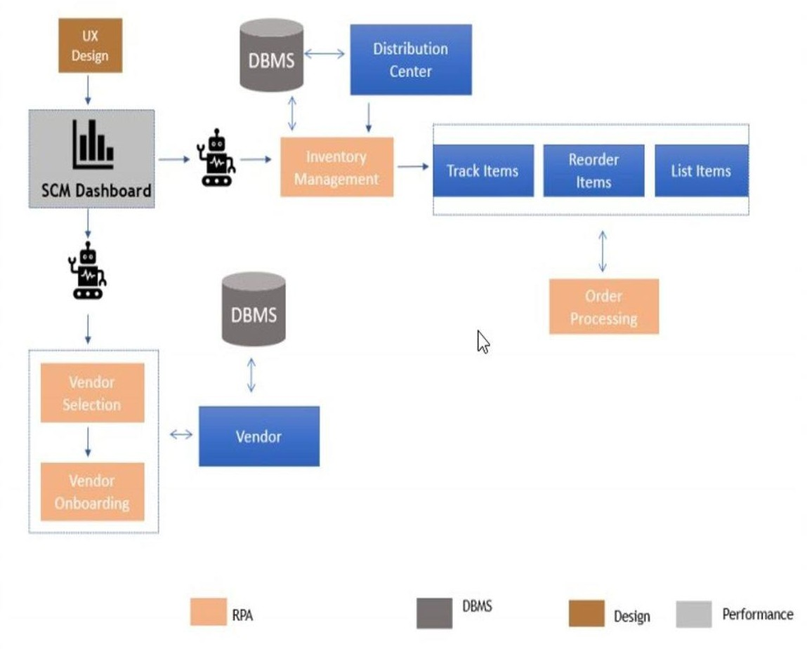
PROPOSED SYSYTEM ARCHITECTURE/WORKING
https://lucid.app/lucidchart/invitations/accept/inv_7d8e1ff2-74bd-4f0b-a543-
a59a81842f9f?viewport_loc=-1341%2C79%2C4377%2C1696%2C0_0

Slide 9
IMPLEMENTATION STATUS
Successfully automated the task of scanning the database to find which products need to be restocked.
Automated the process of sending an email to the appropriate vendor for
ordering the required products.
Successfully modified(increased) the quantity of the products upon restocking, after receiving the 'Order Delivered' email from the vendor.

Slide 10
STATUS OF PAPER DRAFT & TARGETED CONFERENCE
Paper completed , approved by guide and submitted in following conferences:-
3RD International Conference on Deep Learning, Artificial Intelligence and Robotics, (ICDLAIR) 2021
Paper submission deadline: 6 September 2021 https://icdlair2021.iaasse.org/index.html
ISDA 2021 : The 21st International Conference on Intelligent Systems Design
and Applications
Paper submission deadline: 30 September 2021
Conference Date: Dec 13, 2021 - Dec 15, 2021
http://www.mirlabs.org/isda21/welcome.php

Slide 11
Thank You...!!

